Slide 1
Cable Loss Calibration SOP
*Cycle: 1time/week

Slide 2
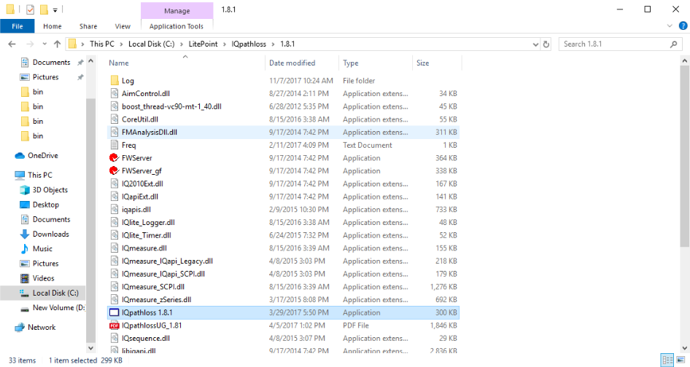
Step 1: Run IQpathloss 1.8.1 program.

Slide 3
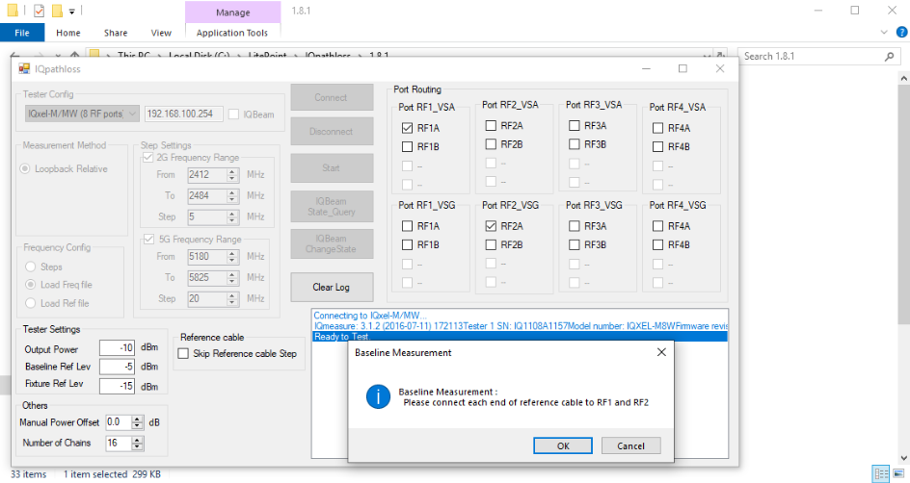
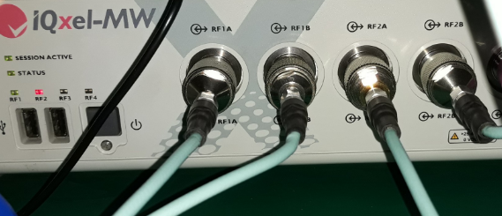
Step 2: IQpathloss windows is appeared as shown below, just follow step by step:
►Select IQxel device(1) → Set IP (2) → then Connect(3).
►Set Number of chains(4) → Select port routing(5)(6) → Click Start(7)
→ connect RF1A to RF2A by RF cable then click OK(8).
3
1
2
5
7
6
4
8

Slide 4
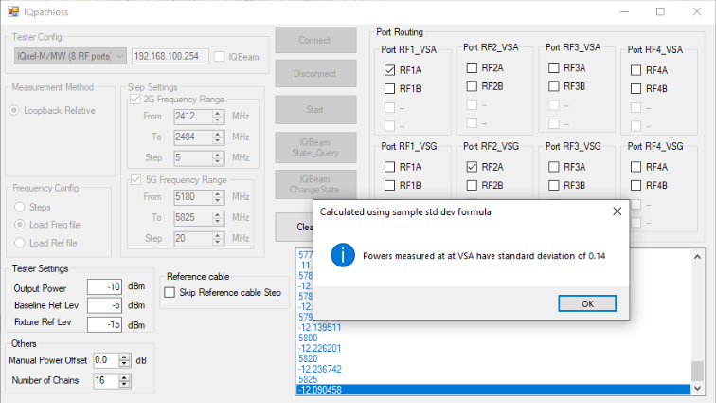
Step 3: Waiting for IQpathloss measuring, then click OK.

Slide 5
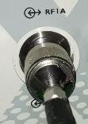
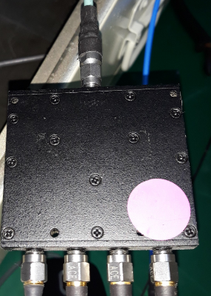
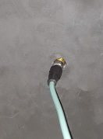
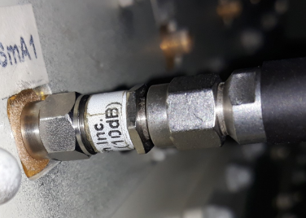
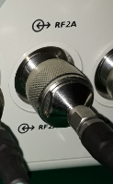
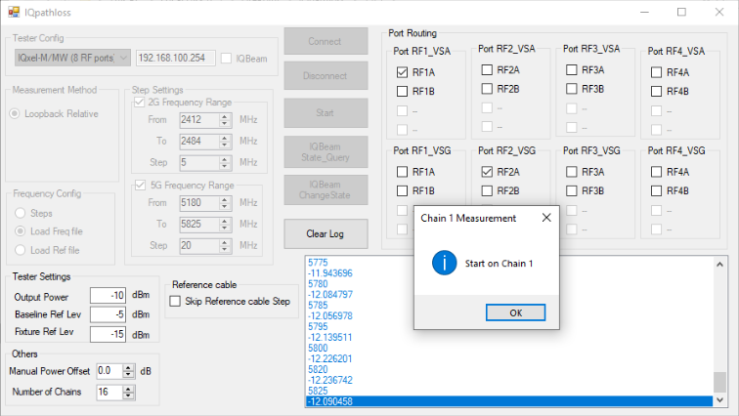
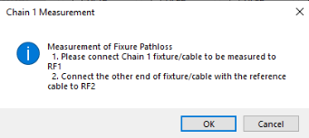
Step 4: IQpathloss inform Start on Chain 1, click OK(1) → Connect the RF cable to Chain1
as the below pictures → click OK(2)
Shelding box
10dB atenuatator
Devider input
Chain1
RF1A IQxel
2
1

Slide 6
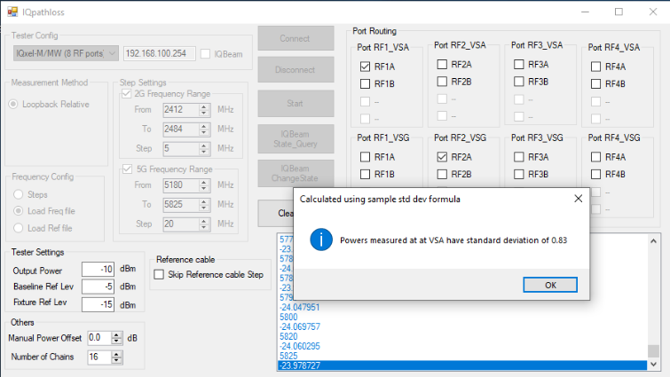
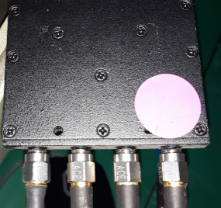
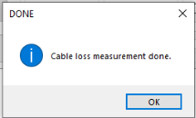
Step 5: Waiting for Chain1 measurement results, click OK(1)
► Repeat step 5 until IQpathloss inform Start on Chain 5, insert RF cable to Chain2
► Repeat step 5 until IQpathloss inform Start on Chain 9, insert RF cable to Chain3
► Repeat step 5 until IQpathloss inform Start on Chain 13, insert RF cable to Chain4
► Repeat step 5 until IQpathloss inform Cable loss measurement done., click OK(2)
Power divider
2
Chain4
Chain3
Chain2
Chain1
1

Slide 7
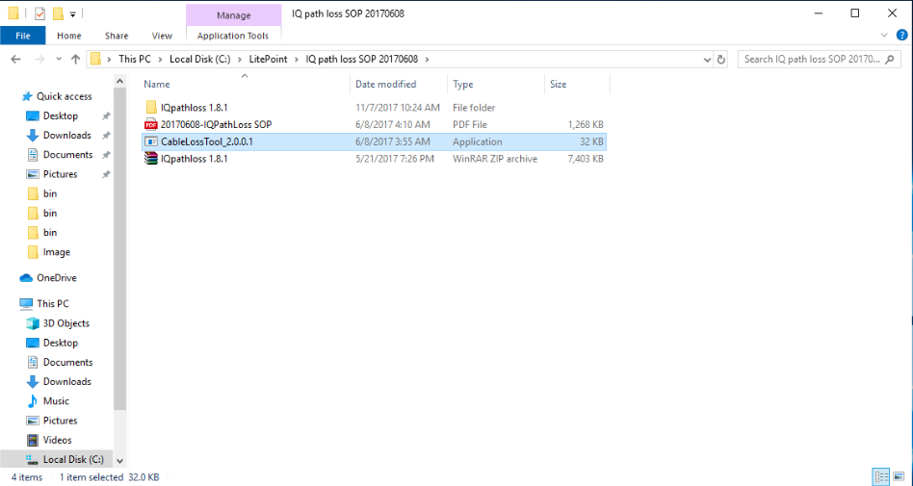
Step 6: Run CableLossTool_2.0.0.1 program.

Slide 8
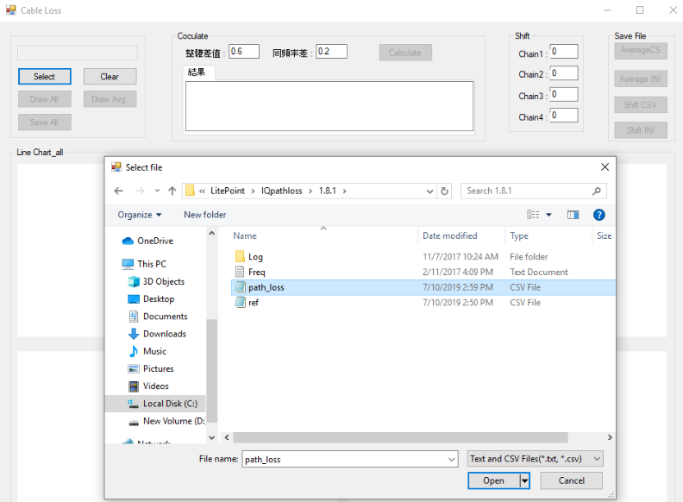
Step 7: Click select(1) → Link to path_loss file(2) → Click Open(3).
1
2
3

Slide 9
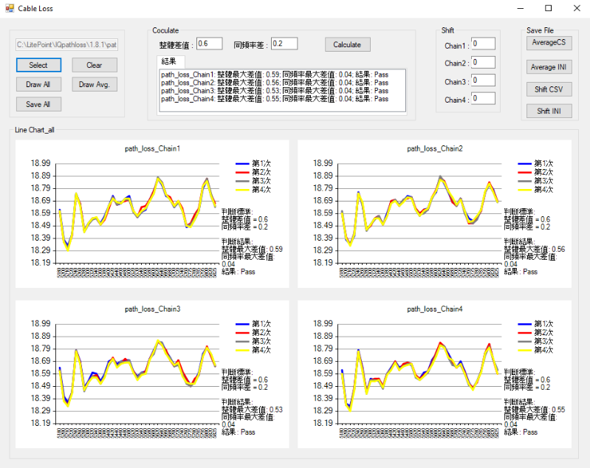
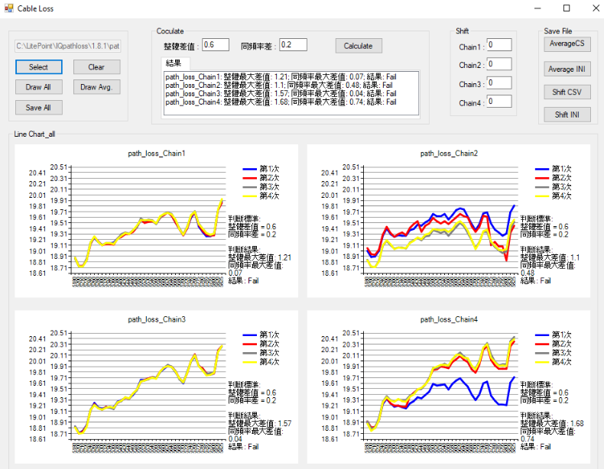
Step 8: Cable loss result PASS/FAIL will be shown as the below:
►On the case FAIL, check again the connections then proceed cable loss again.
►On the case PASS, move to Step 9.
PASS
FAIL

Slide 10
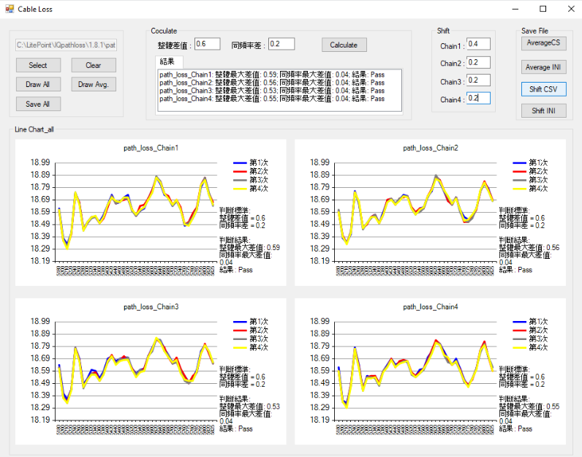
Step 9: Set Shift value(1) → Click Shift CSV(2).
1
2

Slide 11
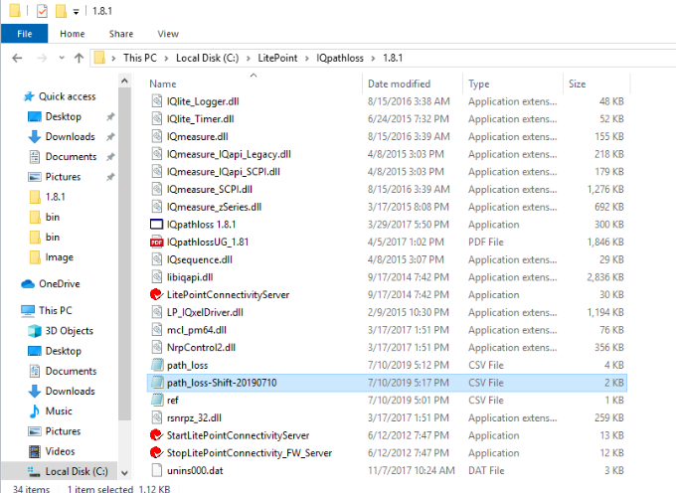
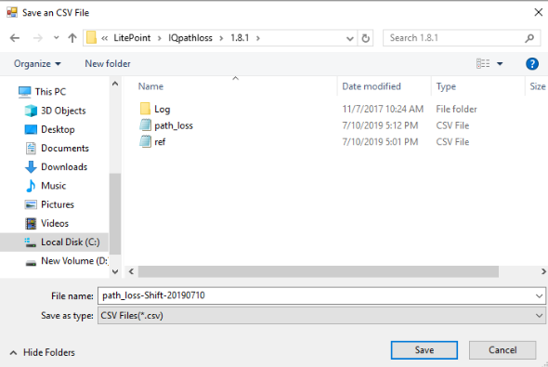
Step 10: Link path_loss-Shift-yyyymmdd file to the ‘C:\LitePoint\Iqpathloss\1.8.1’ (1)→ Save(2)
path_loss-Shift-yyyymmdd csv file is saved. Cable Loss Calibraton is DONE.
1
2

Slide 12
Thank you!

